Slide 1
Assignment1
Group 6:
Chengchao Fang
Chentao Han
Kai Wang
Yiran Jin

Slide 2
Actors
Moderator: is a host who starts whole process
User: all users in the application
API: the interface which can provide outside information

Slide 3
Use Cases
Create Group: moderator can use this to create a movie watching group
Invite User: moderator can invite user to join a group
Provide Movie List(Search): moderator can provide movie list for user to search and browse by API
Create Watching Event: moderator can create a movie watching event
Open/Close Vote: moderator can open and close a voting period for a specific movie watching event
Inform User to Vote: users can be informed a movie watching event was created and they can vote for movies

Slide 4
Use Cases
Keep history: moderator can keep history of movie watching event
Elect Winner: moderator can elect a winner of movies in each movie watching event according to users’ vote
Leave Group: user can leave a group
Watch Trailer: user can watch trailers of movie provided by API
Access Reviews: user can access reviews of movies provided by API

Slide 5
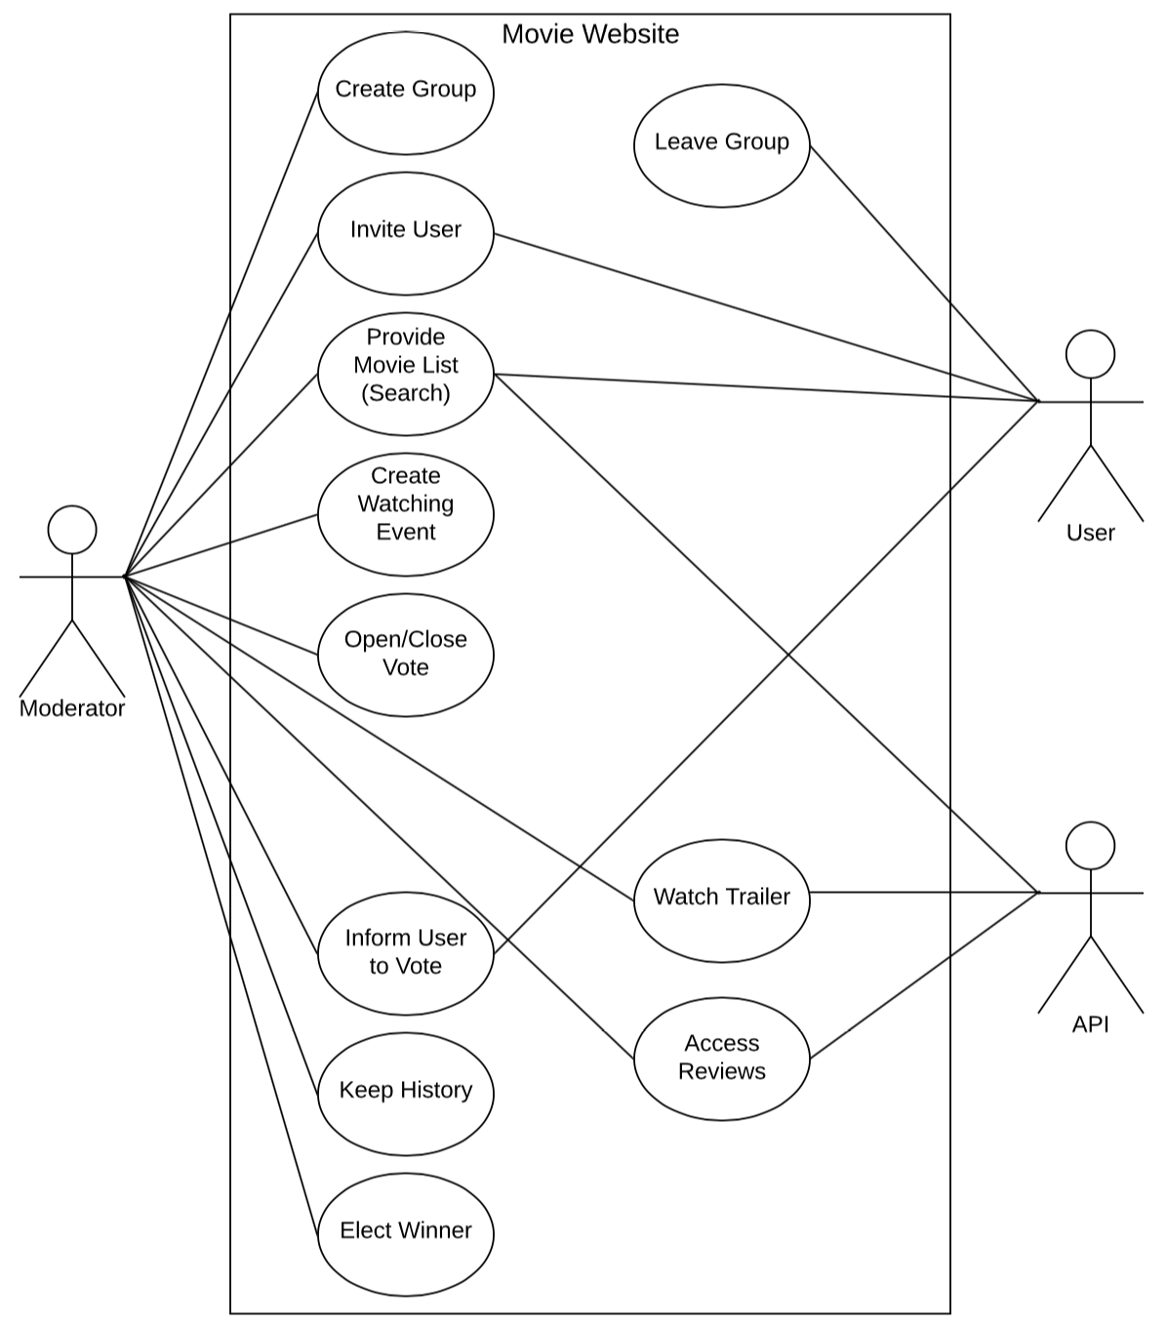
Use Case Diagram

